Slide 1


Title: AI-powered Interview Assessment Tool
CSD 415 Project Phase-1
SUPERVISOR NAME: Presented By,
Dr. Remya R TEAM MEMBERS:
Associate professor AI Amith Sahadevan, PRC22CA006
Rahul Sandesh, PRC22CA022
Shesna S, PRC22CA025
Date: 22-10-2025

Slide 2
CONTENTS
Introduction
Literature Review
Gaps Identified
Objectives
Proposed Methodology
Results And Discussion
Conclusion
References

Slide 3
INTRODUCTION
Background: High application volumes make traditional recruitment screening slow and expensive. Consequently, the HR industry is turning to Artificial Intelligence to drive efficiency and gain a competitive advantage.
Existing System: Traditional methods like resume reviews only assess technical skills, completely missing crucial soft skills and professional demeanor.

Slide 4
INTRODUCTION
Concept: Our project creates an intelligent tool to provide a deep, objective analysis of a candidate's total communication skills.

Slide 5
LITERATURE SURVEY SUMMARY
Title | Author name & Year | Methodology Used | Advantages | Remarks/ Disadvantages
AI Based Interview Evaluator: An Emotion and Confidence Classifier | Mrs. Navya S Rai, Abhiram K R, Adithya P, Hrithik N R (2024) | Deepface and Haar Cascade models( emotion recognition) Google Speech Recognition (Speech-to-Text) Compares transcribed text against predefined answers. (Knowledge Assessment) | • Provides objective, data-driven assessment, reducing bias. • Offers comprehensive evaluation by combining emotion, confidence, and knowledge. • Automates the initial screening process. | • Accuracy depends heavily on video and audio quality. • Predefined answers may not capture the full depth of a candidate's expertise.
MOCK INTERVIEW EVALUATOR POWERED BY AI | Shashikant V. Golande, Prathamesh Dandage, et al. (2025) | Facial Expression Analysis: Uses computer vision to detect facial landmarks. Voice Modulation & Sentiment Analysis: Evaluates tone, pitch, and sentiment. NLP for Keyword Matching: Analyzes speech for relevant keywords. | • Offers a platform for candidates to practice and get feedback. • Can be used in education to prepare students for interviews. • Focuses on both verbal content and non-verbal delivery. | • Effectiveness relies on the diversity of training data to avoid bias. • Not ideal for roles where creativity is valued over keyword matching.

Slide 6
LITERATURE SURVEY SUMMARY
Title | Author name & Year | Methodology Used | Advantages | Remarks/ Disadvantages
Multimodal Emotion Recognition Based on Facial Expressions, Speech, and Body Gestures | Jingjie Yan, Peiyuan Li, Chengkun Du, et al. (2024) | Multimodal Fusion: Integrates data from facial expressions, speech, and body gestures. Feature Extraction: Uses specialized models like CNN (ResNet) for each modality. Decision Fusion: Combines outputs for a more robust prediction. | • Achieves higher accuracy in emotion recognition than single-modality systems. • Creates a more holistic and reliable understanding of the user's emotional state. | • High system complexity due to processing multiple data sources. • Requires a controlled environment for high-quality data capture.
AST: Audio Spectrogram Transformer | Yuan Gong, Yu-An Chung, James Glass (2021) | Proposes the Audio Spectrogram Transformer (AST) , a purely attention-based model for audio classification without CNNs. Treats an audio spectrogram as an image and processes it with a Transformer architecture. | • Outperforms traditional CNN-based models in audio classification tasks. • Better at capturing long-range dependencies in the audio signal. | • Computationally intensive and requires large amounts of training data. • Highly specialized for audio; needs integration with other models for a full system.

Slide 7
GAPS IDENTIFIED
No Unified Systems
Keyword Dependency
Superficial Soft Skill Analysis
Unaddressed Algorithmic Bias
Static Conversation Flow

Slide 8
PROBLEM STATEMENT & OBJECTIVES
Traditional interviews are inefficient and biased. We are creating an automated system to provide fair, consistent assessments of communication skills, which standardizes initial screening and reduces the workload for recruiters.
OBJECTIVES
Voice-Based Interviews
Non-Verbal & Body Language Analysis
Vocal Tone & Speech Pattern Analysis
Automated & Unbiased Feedback

Slide 9
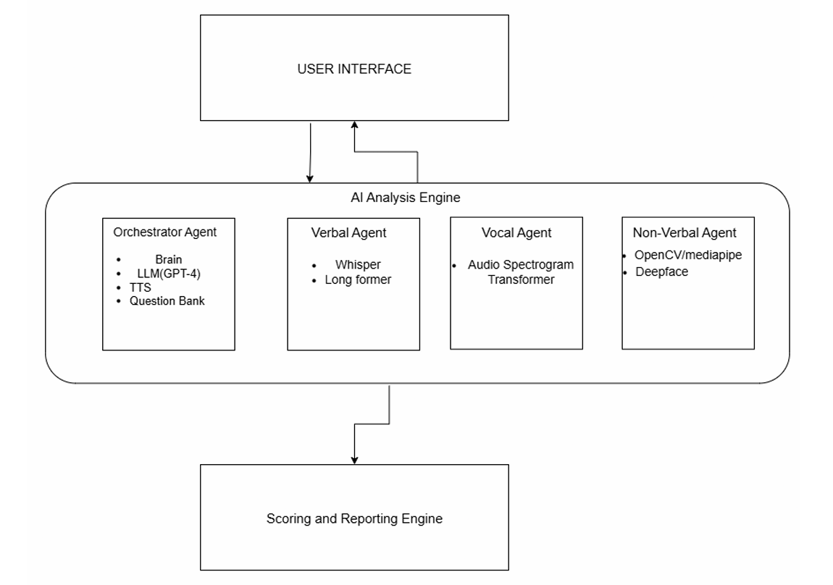
PROPOSED METHODOLOGY
Librosa
spaCy

Slide 10
PROPOSED METHODOLOGY
ARCHITECTURE
Frontend / User Interface
Function: The web-based interface where the candidate interacts with the AI.
Technology: React or Vue.js

Slide 11
PROPOSED METHODOLOGY
Orchestrator Agent (The AI Interviewer)
Function: The "brain" of the operation. It manages the entire interview process, from greeting the candidate to asking questions and ending the session.
Technology:
Large Language Model (LLM): A powerful LLM (like GPT-4, Llama 3, or a fine-tuned open-source model) to generate natural, conversational dialogue.

Slide 12
PROPOSED METHODOLOGY
Technology ( Contd. )
Text-to-Speech (TTS): To convert the LLM's text responses into spoken words.
Question Bank: A database of pre-selected interview questions that the orchestrator pulls from.
How it works: It initiates the conversation, selects a question from the bank, sends it to the TTS service to be spoken aloud, and then activates the other agents to begin analysis.

Slide 13
PROPOSED METHODOLOGY
Specialized Analysis Agents
These agents work in parallel to process the candidate's response.
A. Verbal Analysis Agent (The Scribe & Analyst)
Function: To understand what the candidate is saying.
Technology:
Speech-to-Text (STT): A highly accurate model (like Whisper) to transcribe the candidate's spoken answer into text.

Slide 14
PROPOSED METHODOLOGY
Technology ( Contd. )
spaCy: A fast and robust NLP library for tasks like tokenization, named entity recognition, and part-of-speech tagging.
Output: A score based on the content and quality of the answer.

Slide 15
PROPOSED METHODOLOGY
B. Vocal Analysis Agent (The Tone Analyzer)
Function: To analyze how the candidate is speaking.
Technology:
Vocal Analysis Agent: Processes the raw audio stream to extract features like pitch, pace, and filler word usage.
Output: A confidence score based on vocal delivery.

Slide 16
PROPOSED METHODOLOGY
C. Non-Verbal Analysis Agent (The Body Language Expert)
Function: To analyze the candidate's body language and facial expressions.
Technology:
Computer Vision Models: Using libraries like OpenCV and MediaPipe.

Slide 17
PROPOSED METHODOLOGY
Technology ( Contd. )
As seen in the "AI Based Interview Evaluator" paper, it can use Deepface for emotion recognition and Haar Cascades to track facial landmarks for cues like eye contact, head movement, and expressions. This aligns with the findings of the "Multimodal Emotion Recognition" paper, which confirms that combining these cues is highly effective.
Output: An engagement score based on non-verbal cues.

Slide 18
PROPOSED METHODOLOGY
Scoring & Reporting Engine
Function: This component gathers the individual scores and analyses from all the specialized agents.
Technology: A backend service that applies a weighted algorithm to combine the scores from the Verbal, Vocal, and Non-Verbal agents into a single, overall performance score.
Output: It generates a comprehensive report detailing the candidate's performance in each area, along with the final score.

Slide 19
PROPOSED METHODOLOGY
DATASETS
Interview Question Datasets (Text-Based)
Sources: GitHub, Kaggle
Behavioural / Psychological Interview Dataset
Sources: DAIC-WOZ Dataset
Video Datasets with Body Language
RAVDESS Dataset

Slide 20
PROPOSED METHODOLOGY
HARDWARE REQUIREMENTS
For Development & Training
GPU: NVIDIA RTX 3080 / 4070 or higher (at least 12 GB VRAM).
CPU: Intel i7/i9 or AMD Ryzen 7/9
RAM: 32 GB minimum, 64 GB recommended.
Storage: At least 1 TB of fast NVMe SSD storage.

Slide 21
PROPOSED METHODOLOGY
For Deployment (Live Application)
Server-Side:
GPU: Server-grade GPU for real-time inference (e.g., NVIDIA T4 or A10G).
CPU & RAM: Multi-core server CPU with at least 32 GB of RAM.

Slide 22
PROPOSED METHODOLOGY
Client-Side (The Candidate):
Computer: Standard modern laptop/desktop.
Webcam: HD quality (720p minimum).
Microphone: Clear, high-quality audio input.
Internet: Stable, high-speed connection.

Slide 23
PROPOSED METHODOLOGY
SOFTWARE REQUIREMENTS
Core Stack & AI Frameworks
Language: Python 3.9+
Core Libraries: NumPy, Pandas, Scikit-learn
Deep Learning: PyTorch or TensorFlow
NLP Models: Hugging Face Transformers

Slide 24
PROPOSED METHODOLOGY
Specialized Libraries by Agent
Verbal (Speech & Text): Whisper, spaCy
Vocal (Audio Analysis): Librosa
Non-Verbal (Video Analysis): OpenCV, MediaPipe, DeepFace

Slide 25
PROPOSED METHODOLOGY
Application & Development Tools
Backend: Django or Flask
Frontend: React or Vue.js
IDE & Notebooks: VS Code, Jupyter, Google Colab
Version Control: Git / GitHub

Slide 26
Thank You

Slide 27
Implementation/Work done so far

Slide 28
Results and Discussion

Slide 29
CONCLUSION

Slide 30
REFERENCES
//sample
// site from google scholar ->cite-> choose APA
[1] Dapeng Cheng, Xiaolian Gao, Yanyan Mao, Baozhen Xiao, Panlu You, Jiale Gai, Minghui
Zhu, Jialong Kang, Feng Zhao, and Ning Mao. Brain tumor feature extraction and edge
enhancement algorithm based on u-net network. Heliyon, 9(11), 2023.
[2]

